Slide 1
Practical Implementations of the Ensemble Kalman Filter Jeff Anderson representing the NCAR Data Assimilation Research Section

Slide 2
Building a Forecast System
Prediction Model
Observing System
Observations
Forecasts
Initial
Conditions
Data Assimilation
Analysis

Slide 3
The Data Assimilation Research Testbed (DART)
DART provides data assimilation ‘glue’ to build state-of-the-art ensemble forecast systems for even the largest models.
Prediction Model
Observing System
DART
Analysis

Slide 4
DART Goals
Provide State-of-the-Art Data Assimilation capability to:
Prediction research scientists,
Model developers,
Observation system developers,
Who may not have any assimilation expertise.

Slide 5
DART Design Constraints
Models small to huge.
Few or many observations.
Tiny to huge computational resources.
Entry cost must be low.
Competitive with existing methods for weather prediction:
Scientific quality of results,
Total computational effort.

Slide 6
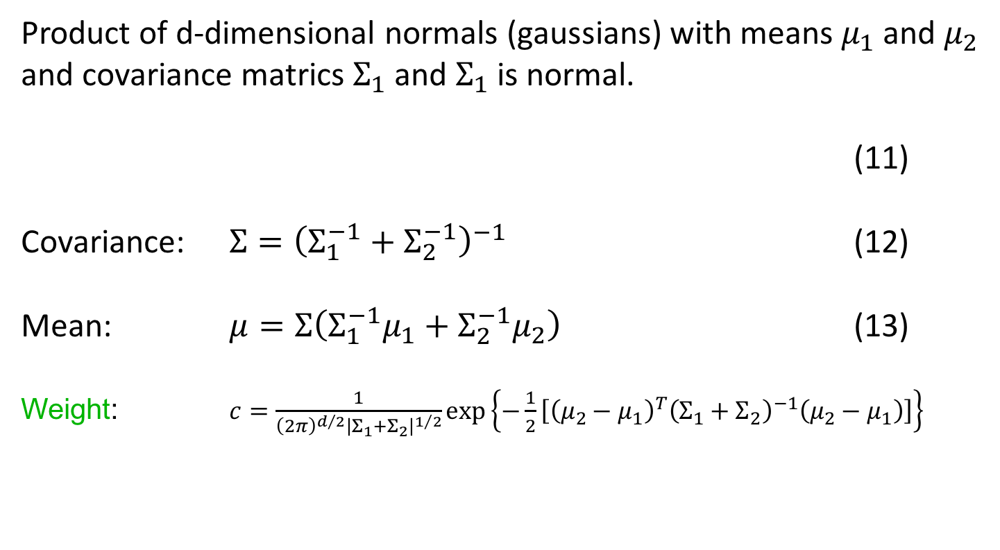
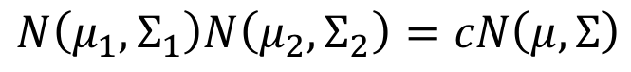
Methods: Kalman Filter
Product of d-dimensional normals (gaussians) with means $μ_{1}$ and $μ_{2}$ and covariance matrics $Σ_{1}$ and $Σ_{1}$ is normal.
(11)
Covariance: $Σ={\left(Σ_{1}^{−1}+Σ_{2}^{−1}\right)}^{−1}$ (12)
Mean: $μ=Σ\left(Σ_{1}^{−1}μ_{1}+Σ_{2}^{−1}μ_{2}\right)$ (13)
Weight: $c=\frac{1}{{\left(2π\right)}^{d/2}{\left|Σ_{1}+Σ_{2}\right|}^{1/2}}exp\left\{−\frac{1}{2}\left[{\left(μ_{2}−μ_{1}\right)}^{T}{\left(Σ_{1}+Σ_{2}\right)}^{−1}\left(μ_{2}−μ_{1}\right)\right]\right\}$
$$N\left(μ_{1},Σ_{1}\right)N\left(μ_{2},Σ_{2}\right)=cN\left(μ,Σ\right)$$
We’ll ignore the weight since we immediately normalize products to be PDFs.

Slide 7
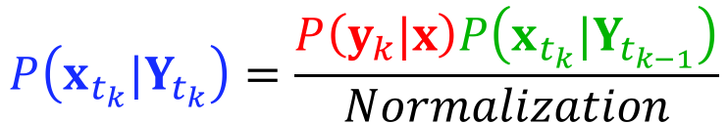
Methods: Kalman Filter
Recall our earlier assimilation update equation.
(10)
Numerator is just product of two gaussians.
Denominator just normalizes posterior to be a PDF.
$$P\left(x_{t_{k}}|Y_{t_{k}}\right)=\frac{P\left(y_{k}|x\right)P\left(x_{t_{k}}|Y_{t_{k−1}}\right)}{Normalization}$$

Slide 8
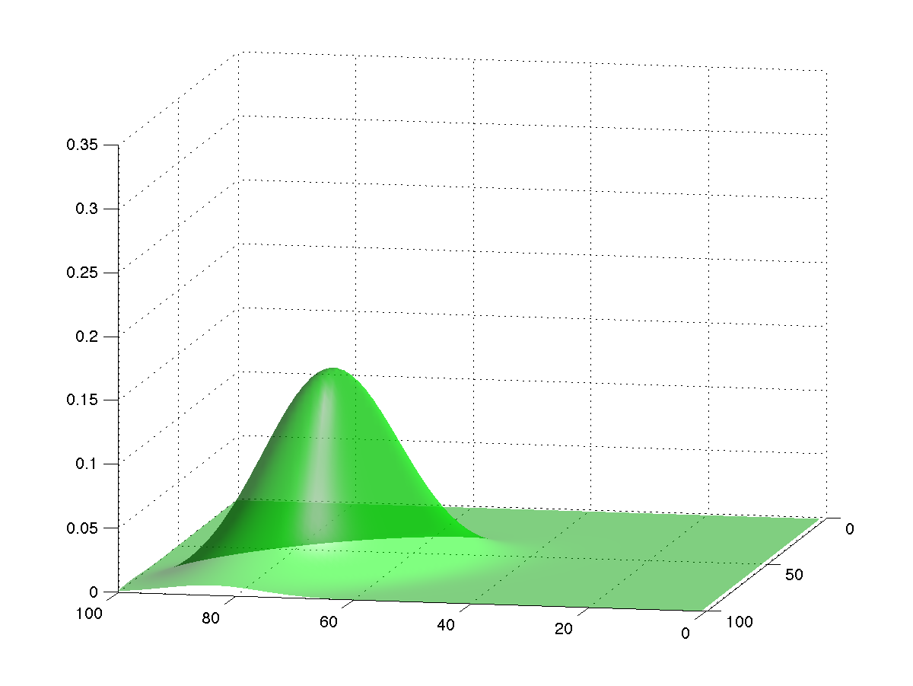
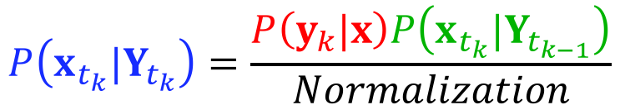
Methods: Kalman Filter
(10)
Prior is gaussian, comes from forecast model.
$$P\left(x_{t_{k}}|Y_{t_{k}}\right)=\frac{P\left(y_{k}|x\right)P\left(x_{t_{k}}|Y_{t_{k−1}}\right)}{Normalization}$$

Slide 9
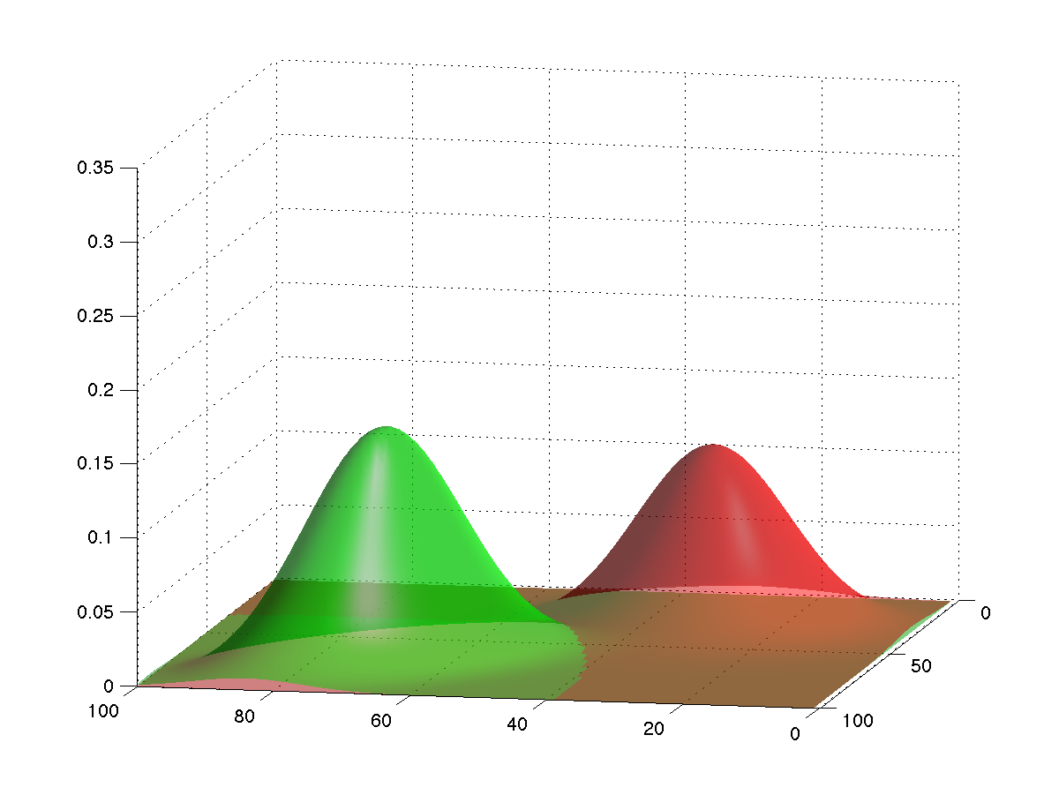
Methods: Kalman Filter
(10)
Likelihood is gaussian, mean measured, covariance from designer.
$$P\left(x_{t_{k}}|Y_{t_{k}}\right)=\frac{P\left(y_{k}|x\right)P\left(x_{t_{k}}|Y_{t_{k−1}}\right)}{Normalization}$$

Slide 10
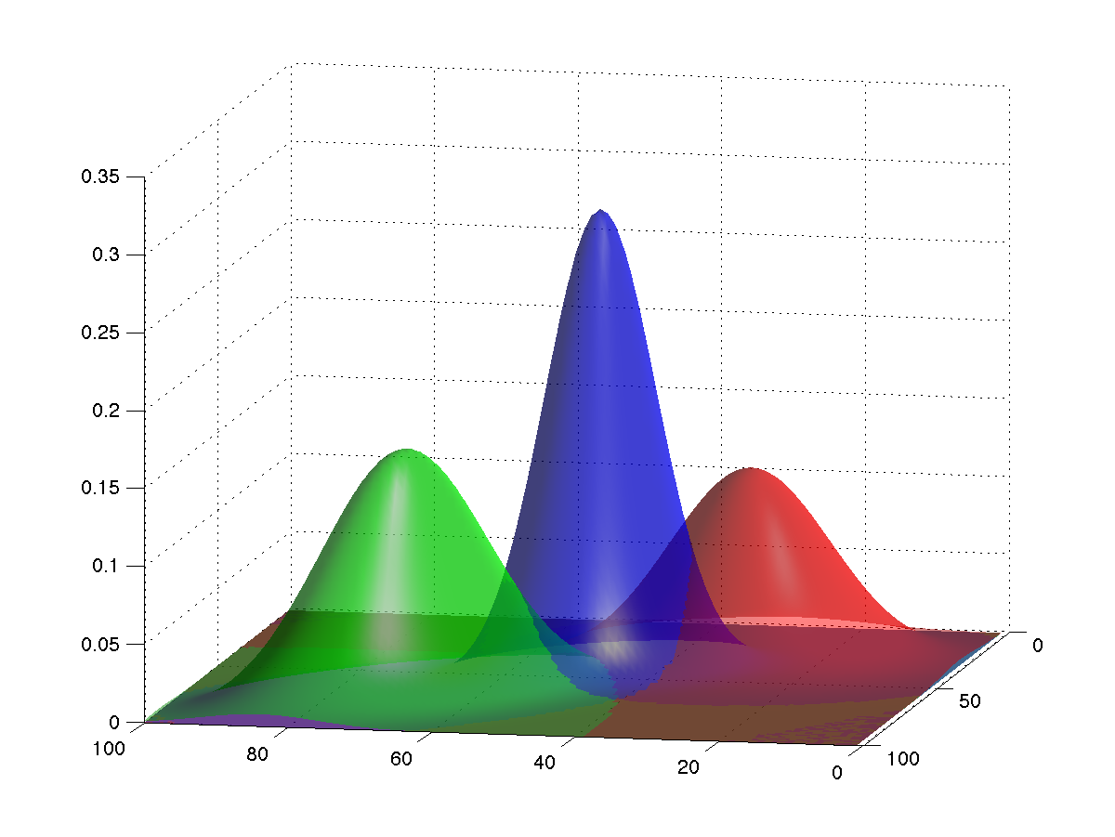
Methods: Kalman Filter
(10)
Posterior is gaussian, from (11).
$$P\left(x_{t_{k}}|Y_{t_{k}}\right)=\frac{P\left(y_{k}|x\right)P\left(x_{t_{k}}|Y_{t_{k−1}}\right)}{Normalization}$$

Slide 11
A Fast, Simple, Sequential Ensemble Kalman Filter
A one-dimensional ensemble Kalman filter.
One observed, one unobserved variable.
Ensemble Kalman Filter: A full implementation.
Making it work:
Localization
Inflation
Parameter estimation.
Some sample applications.

Slide 12
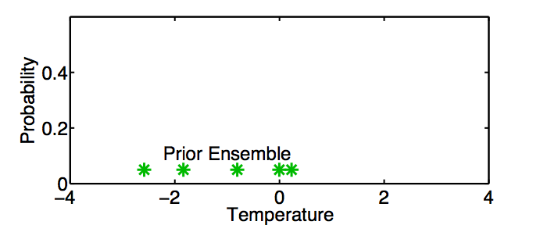
A One-Dimensional Ensemble Kalman Filter
Represent a prior pdf by a sample (ensemble) of N values:
Example: Predict temperature on the Nanjing campus.

Slide 13
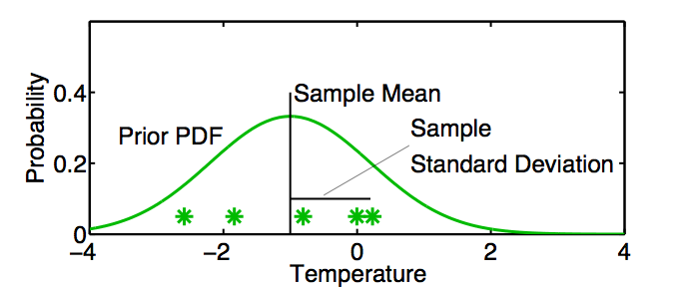
A One-Dimensional Ensemble Kalman Filter
Represent a prior pdf by a sample (ensemble) of N values:
Use sample mean
and sample standard deviation
to determine a corresponding continuous distribution

Slide 14
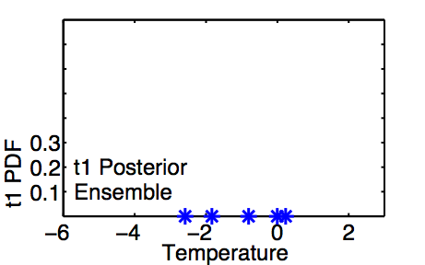
A One-Dimensional Ensemble Kalman Filter: Model Advance
If posterior ensemble at time t₁ is T_{1,n}, n = 1, …, N

Slide 15
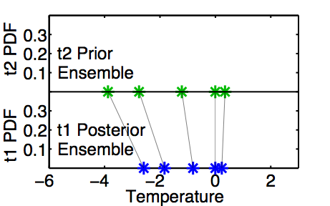
A One-Dimensional Ensemble Kalman Filter: Model Advance
If posterior ensemble at time t₁ is T_{1,n}, n = 1, …, N ,
advance each member to time t₂ with model, T_{2,n} = L(T_{1, n}) n = 1, …,N .

Slide 16
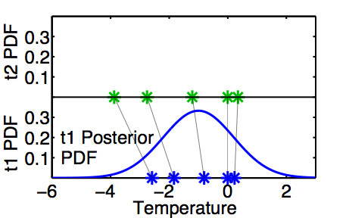
A One-Dimensional Ensemble Kalman Filter: Model Advance
Same as advancing continuous pdf at time t₁ …

Slide 17
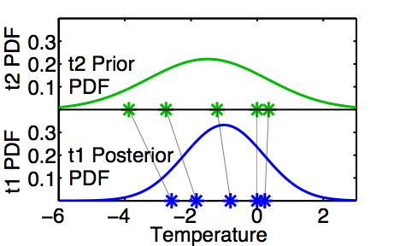
A One-Dimensional Ensemble Kalman Filter: Model Advance
Same as advancing continuous pdf at time t₁
to time t₂ with model L.

Slide 18
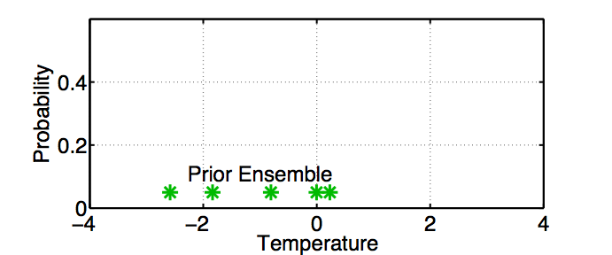
One-Dimensional Ensemble Kalman Filter: Assimilating an Observation

Slide 19
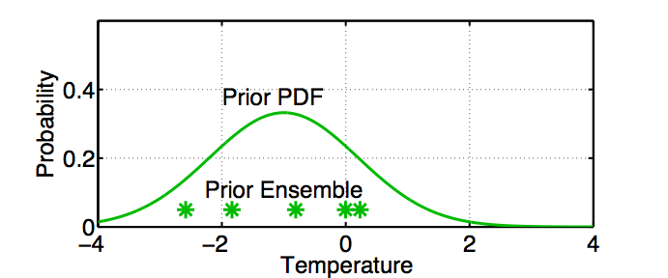
One-Dimensional Ensemble Kalman Filter: Assimilating an Observation
Fit a Gaussian to the sample.

Slide 20
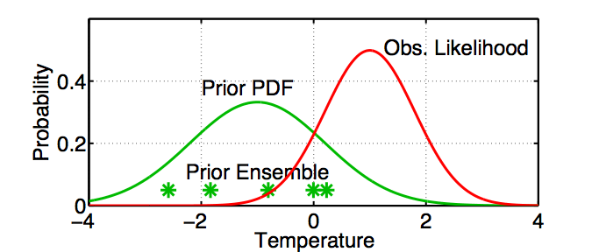
One-Dimensional Ensemble Kalman Filter: Assimilating an Observation
Get the observation likelihood.

Slide 21
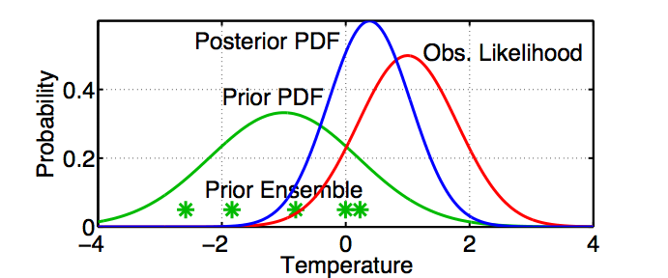
One-Dimensional Ensemble Kalman Filter: Assimilating an Observation
Compute the continuous posterior PDF.

Slide 22
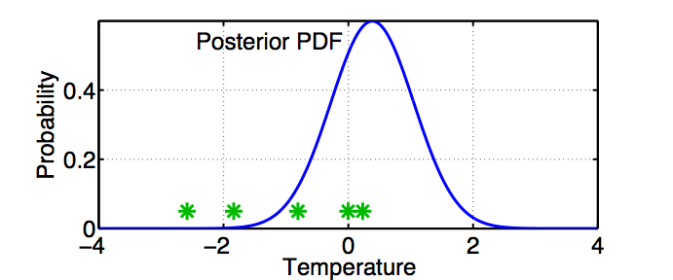
One-Dimensional Ensemble Kalman Filter: Assimilating an Observation
Use a deterministic algorithm to ‘adjust’ the ensemble.

Slide 23
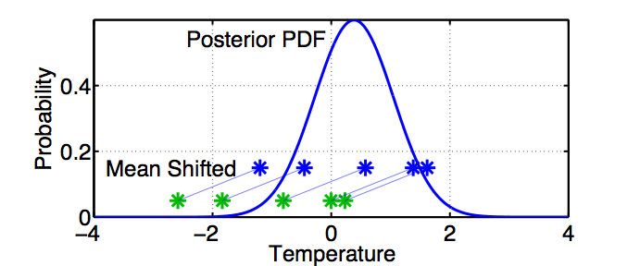
One-Dimensional Ensemble Kalman Filter: Assimilating an Observation
First, ‘shift’ the ensemble to have the exact mean of the posterior.

Slide 24
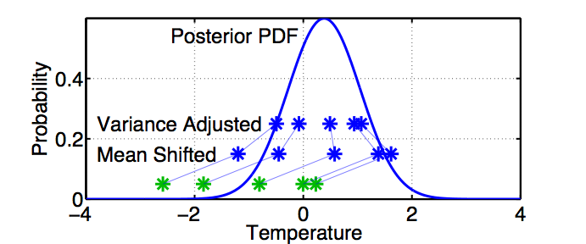
One-Dimensional Ensemble Kalman Filter: Assimilating an Observation
First, ‘shift’ the ensemble to have the exact mean of the posterior.
Second, linearly contract to have the exact variance of the posterior.
Sample statistics are identical to Kalman filter.

Slide 25
A Fast, Simple, Sequential Ensemble Kalman Filter
A one-dimensional ensemble Kalman filter.
One observed, one unobserved variable.
Ensemble Kalman Filter: A full implementation.
Making it work:
Localization
Inflation
Parameter estimation.
Some sample applications.

Slide 26
One observed, one unobserved variable.
So far, we have a known observation likelihood for a single variable.
Now, suppose the model state has an additional variable,
temperature at Shanghai.
How should ensemble members update the additional variable?

Slide 27
One observed, one unobserved variable.
Assume that all we know is the prior joint distribution.
One variable is observed.
What should happen to the unobserved variable?
Notes:
s11f01.eps

Slide 28
One observed, one unobserved variable.
Assume that all we know is the prior joint distribution.
One variable is observed.
Update observed variable with ensemble Kalman filter.
Notes:
s11f02.eps

Slide 29
One observed, one unobserved variable.
Assume that all we know is the prior joint distribution.
One variable is observed.
Update observed variable with ensemble Kalman filter.
Notes:
s11f03.eps

Slide 30
One observed, one unobserved variable.
Assume that all we know is the prior joint distribution.
One variable is observed.
Update observed variable with ensemble Kalman filter.
Notes:
s11f04.eps

Slide 31
One observed, one unobserved variable.
Assume that all we know is the prior joint distribution.
One variable is observed.
Compute increments for prior ensemble members of observed variable.
Notes:
s11f06.eps

Slide 32
One observed, one unobserved variable.
Assume that all we know is the prior joint distribution.
One variable is observed.
Compute increments for prior ensemble members of observed variable.
Notes:
s11f07.eps

Slide 33
One observed, one unobserved variable.
Assume that all we know is the prior joint distribution.
One variable is observed.
Compute increments for prior ensemble members of observed variable.
Notes:
s11f08.eps

Slide 34
One observed, one unobserved variable.
Assume that all we know is the prior joint distribution.
One variable is observed.
Compute increments for prior ensemble members of observed variable.
Notes:
s11f09.eps

Slide 35
One observed, one unobserved variable.
Assume that all we know is the prior joint distribution.
One variable is observed.
Compute increments for prior ensemble members of observed variable.
Notes:
s11f010.eps

Slide 36
One observed, one unobserved variable.
Using only increments guarantees that if observation had no impact on observed variable, the unobserved variable is unchanged.
Highly desirable!
Notes:
s11f11.eps

Slide 37
One observed, one unobserved variable.
Assume that all we know is the prior joint distribution.
How should the unobserved variable be impacted?
1st choice: least squares
Equivalent to linear regression.
Same as assuming binormal prior.
Notes:
s11f12.eps

Slide 38
One observed, one unobserved variable.
Have joint prior distribution of two variables.
How should the unobserved variable be impacted?
1st choice: least squares
Begin by finding least squares fit.
Notes:
s11f13.eps

Slide 39
One observed, one unobserved variable.
Have joint prior distribution of two variables.
Next, regress the observed variable increments onto increments for the unobserved variable.
Equivalent to first finding image of increment in joint space.
Notes:
s11f14.eps

Slide 40
One observed, one unobserved variable.
Have joint prior distribution of two variables.
Next, regress the observed variable increments onto increments for the unobserved variable.
Equivalent to first finding image of increment in joint space.
Notes:
s11f15.eps

Slide 41
One observed, one unobserved variable.
Have joint prior distribution of two variables.
Next, regress the observed variable increments onto increments for the unobserved variable.
Equivalent to first finding image of increment in joint space.
Notes:
s11f16.eps

Slide 42
One observed, one unobserved variable.
Have joint prior distribution of two variables.
Next, regress the observed variable increments onto increments for the unobserved variable.
Equivalent to first finding image of increment in joint space.
Notes:
s11f17.eps

Slide 43
One observed, one unobserved variable.
Have joint prior distribution of two variables.
Next, regress the observed variable increments onto increments for the unobserved variable.
Equivalent to first finding image of increment in joint space.
Notes:
s11f18.eps

Slide 44
One observed, one unobserved variable.
Have joint prior distribution of two variables.
Regression: Equivalent to first finding image of increment in joint space.
Then projecting from joint space onto unobserved priors.
Notes:
s11f19.eps

Slide 45
One observed, one unobserved variable.
Have joint prior distribution of two variables.
Regression: Equivalent to first finding image of increment in joint space.
Then projecting from joint space onto unobserved priors.
Notes:
s11f20.eps

Slide 46
One observed, one unobserved variable.
Have joint prior distribution of two variables.
Regression: Equivalent to first finding image of increment in joint space.
Then projecting from joint space onto unobserved priors.
Notes:
s11f21.eps

Slide 47
One observed, one unobserved variable.
Have joint prior distribution of two variables.
Regression: Equivalent to first finding image of increment in joint space.
Then projecting from joint space onto unobserved priors.
Notes:
s11f22.eps

Slide 48
One observed, one unobserved variable.
Have joint prior distribution of two variables.
Regression: Equivalent to first finding image of increment in joint space.
Then projecting from joint space onto unobserved priors.
Notes:
s11f23.eps
Prepare the audience for the next slide. We are going to expand the left marginal at the expense of the other two. The content is the same.

Slide 49
One observed, one unobserved variable.
Now have an updated (posterior) ensemble for the unobserved variable.
Fitting Gaussians shows that mean and variance have changed.
Other features of the prior distribution may also have changed.
Compressed these two.
We’ve expanded this plot. Same information as previous slides.
Compressed these two.
Notes:
s11f24.eps

Slide 50
One observed, one unobserved variable.
Now have an updated (posterior) ensemble for the unobserved variable.
Fitting Gaussians shows that mean and variance have changed.
Other features of the prior distribution may also have changed.
Notes:
s11f25.eps

Slide 51
One observed, one unobserved variable.
Now have an updated (posterior) ensemble for the unobserved variable.
Fitting Gaussians shows that mean and variance have changed.
Other features of the prior distribution may also have changed.
Notes:
s11f26.eps

Slide 52
A Fast, Simple, Sequential Ensemble Kalman Filter
A one-dimensional ensemble Kalman filter.
One observed, one unobserved variable.
Ensemble Kalman Filter: A full implementation.
Making it work:
Localization
Inflation
Parameter estimation.
Some sample applications.

Slide 53
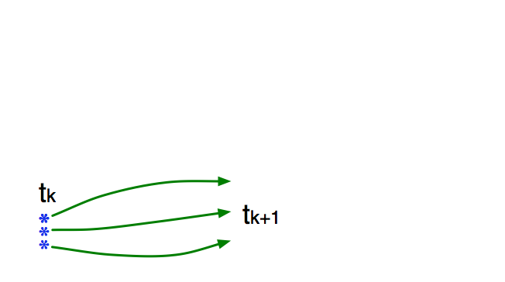
Ensemble Kalman Filter: A full implementation.
Use model to advance ensemble (3 members here) to time at which next observation becomes available.
Ensemble state estimate after using previous observation (analysis)
Ensemble state at time of next observation (prior)

Slide 54
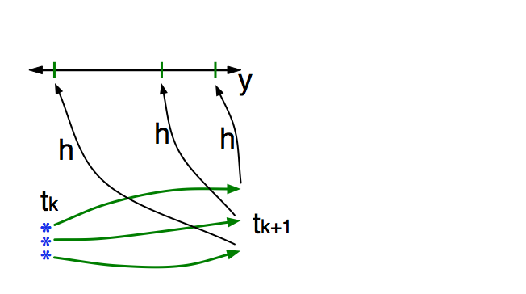
Ensemble Kalman Filter: A full implementation.
Get prior ensemble sample of observation, y = h(x), by applying forward operator h to each ensemble member.
Theory: observations from instruments with uncorrelated errors can be done sequentially.

Slide 55
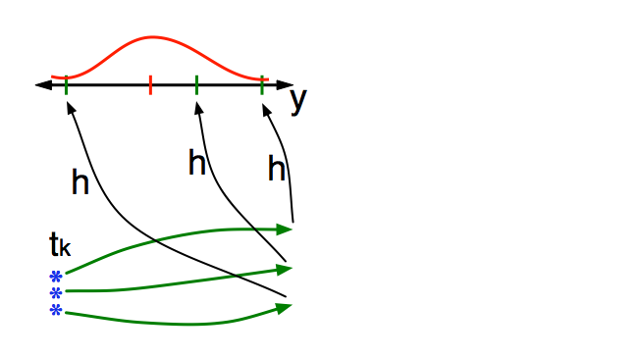
Ensemble Kalman Filter: A full implementation.
Get observed value and observational error distribution from observing system.

Slide 56
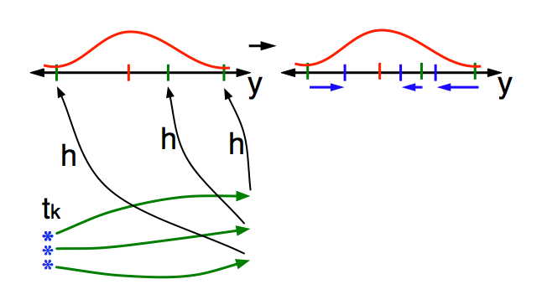
Ensemble Kalman Filter: A full implementation.
Find the increments for the prior observation ensemble (this is a scalar problem for uncorrelated observation errors).

Slide 57
Ensemble Kalman Filter: A full implementation.
Find the increments for the prior observation ensemble (this is a scalar problem for uncorrelated observation errors).
Note: Difference between various ensemble filter methods is primarily in observation increment calculation.

Slide 58
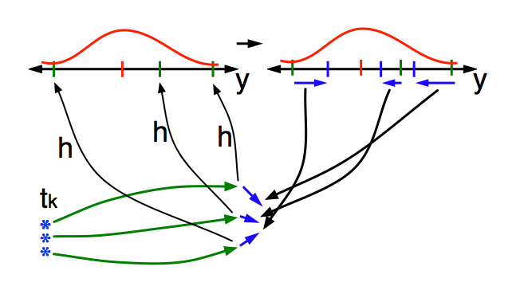
Ensemble Kalman Filter: A full implementation.
Use ensemble samples of y and each state variable to linearly regress observation increments onto state variable increments.

Slide 59
Ensemble Kalman Filter: A full implementation.
Use ensemble samples of y and each state variable to linearly regress observation increments onto state variable increments.
Theory: impact of observation increments on each state variable can be handled independently!

Slide 60
Ensemble Kalman Filter: A full implementation.
Use ensemble samples of y and each state variable to linearly regress observation increments onto state variable increments.
DART updates all state variables in parallel. Variables randomly assigned to processes for load balancing.

Slide 61
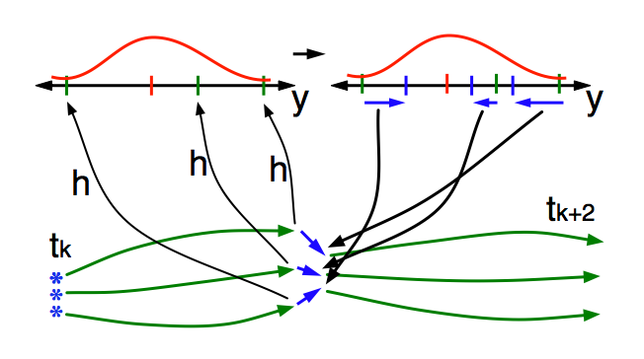
Ensemble Kalman Filter: A full implementation.
When all ensemble members for each state variable are updated, integrate to time of next observation …

Slide 62
Ensemble Kalman Filter: A full implementation.
For linear, gaussian problem:
If, ensemble size N>N_{crit}
Mean and covariance are identical to Kalman Filter,
Else
Diverges.
Ncrit: Number of positive singular values in SVD of covariance matrix.
Notes:
s11f26.eps

Slide 63
Ensemble Kalman Filter: A full implementation.
(Ensemble) KF optimal for linear model, gaussian likelihood, perfect model.
In KF, only mean and covariance have meaning.
Ensemble allows computation of many other statistics.
What do they mean? Not entirely clear.
What do they mean when there are all sorts of error?
Even less clear.
Must Calibrate and Validate results.

Slide 64
A Fast, Simple, Sequential Ensemble Kalman Filter
A one-dimensional ensemble Kalman filter.
One observed, one unobserved variable.
Ensemble Kalman Filter: A full implementation.
Making it work:
Localization
Inflation
Parameter estimation.
Some sample applications.

Slide 65
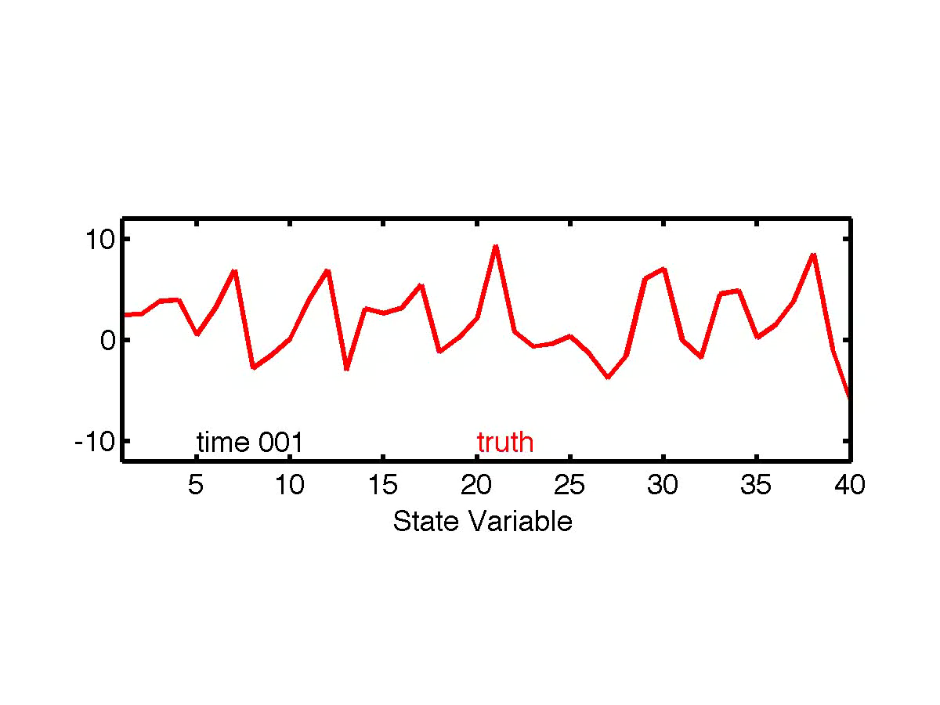
Making it work:
Lorenz-96 low-order model example.
40 state variables: X₁, X₂,..., X₄₀.
dX_{i} / dt = (X_{i+1} - X_{i-2})X_{i-1} - X_{i} + F.
Acts ‘something’ like weather around a latitude band.

Slide 66
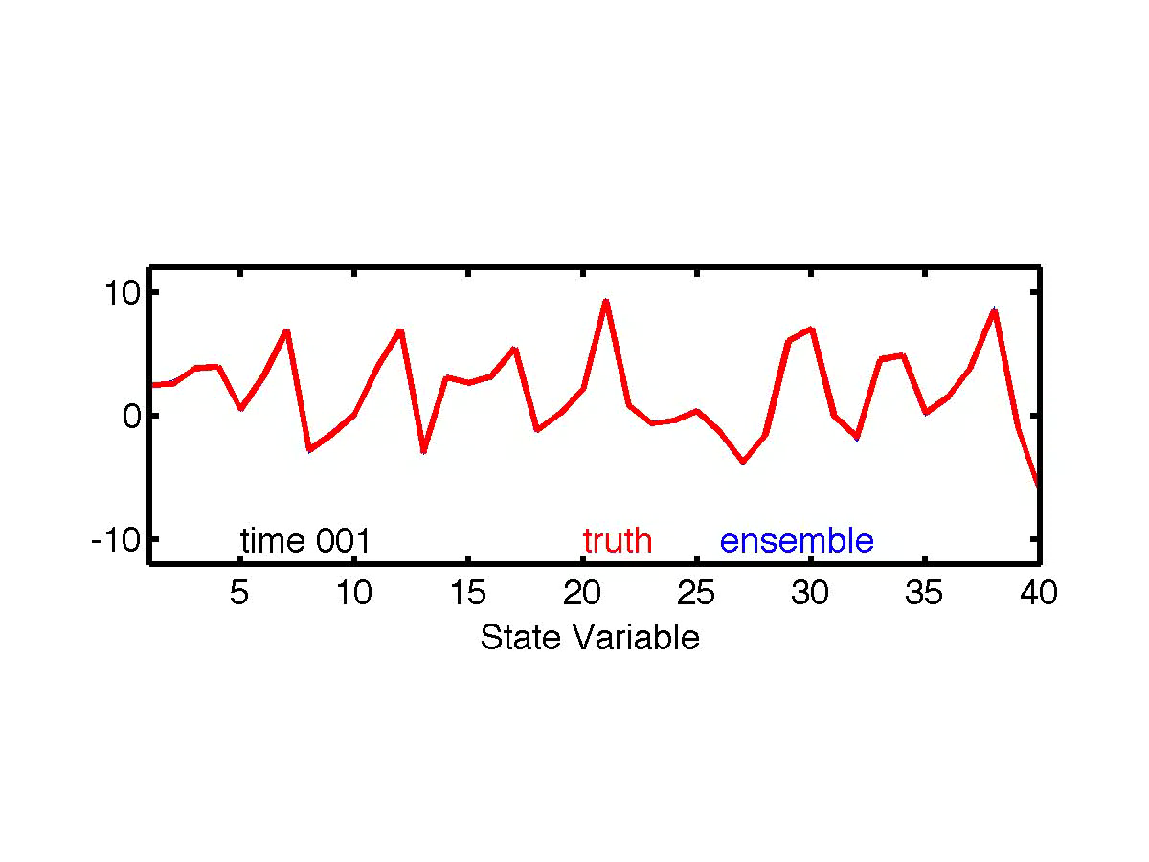
Making it work:
Lorenz-96 is sensitive to small perturbations.
Introduce 20 ‘ensemble’ state estimates.
Each is perturbed for each of the 40-variables at time 0.
Refer to unperturbed control integration as ‘truth’.

Slide 67
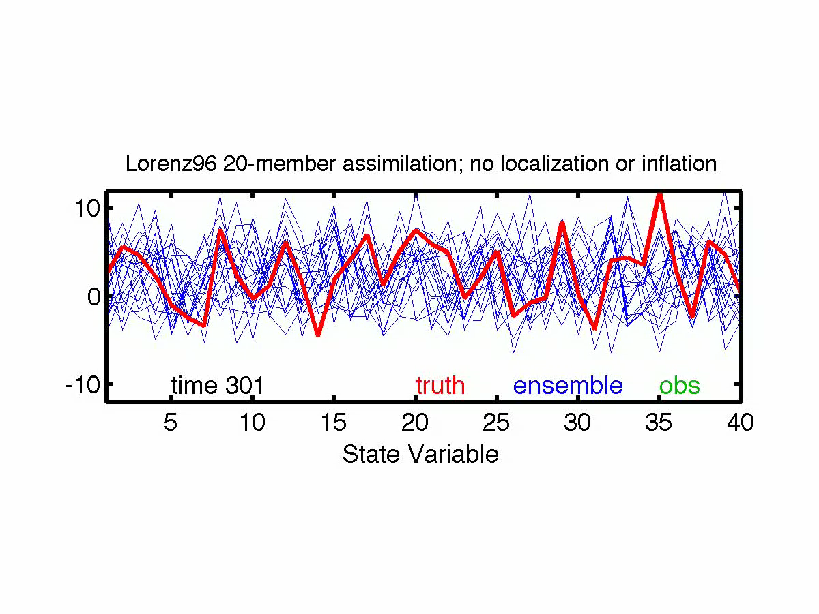
Making it work:
Assimilate ‘observations’ from 40 random locations.
Interpolate truth to station location.
Simulate observational error:
Add random draw from N(0, 16) to each.
Start from ‘climatological’ 20-member ensemble.

Slide 68
Making it work:
Some error sources in ensemble filters.
3. Observation error
4. Sampling Error;
Gaussian Assumption
2. Obs. operator error;
Representativeness
5. Sampling Error;
Assuming Linear
Statistical Relation
1. Model error

Slide 69
A Fast, Simple, Sequential Ensemble Kalman Filter
A one-dimensional ensemble Kalman filter.
One observed, one unobserved variable.
Ensemble Kalman Filter: A full implementation.
Making it work:
Localization
Inflation
Parameter estimation.
Some sample applications.

Slide 70
Making it work: Localization
Sampling Error: Observations Impact Unrelated State Variables
Plot shows expected absolute value of sample correlation vs. true correlation.
Unrelated obs. reduce spread, increase error.
Attack with localization.
Reduce impact of observation on weakly correlated state variables.
Let weight go to zero for many ‘unrelated’ variables to save on computing.

Slide 71
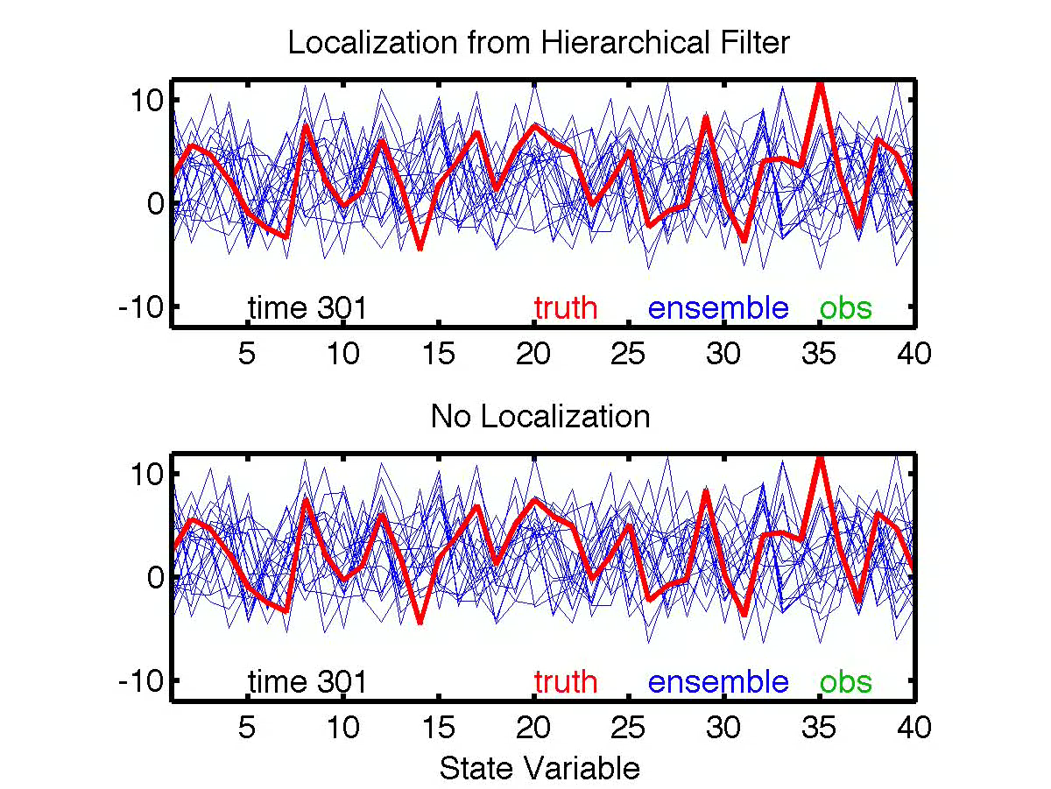
Making it work: Localization

Slide 72
Making it work: Localization

Slide 73
A Fast, Simple, Sequential Ensemble Kalman Filter
A one-dimensional ensemble Kalman filter.
One observed, one unobserved variable.
Ensemble Kalman Filter: A full implementation.
Making it work:
Localization
Inflation
Parameter estimation.
Some sample applications.

Slide 74
Making it work: Inflation
Some error sources in ensemble filters.
3. Observation error
4. Sampling Error;
Gaussian Assumption
2. Obs. operator error;
Representativeness
5. Sampling Error;
Assuming Linear
Statistical Relation
1. Model error

Slide 75
Making it work: Inflation
Assimilating with simulated model error.
dXi / dt = (Xi+1 - Xi-2)Xi-1 - Xi + F.
For truth, use F = 8.
In assimilating model, use F = 6.
Time evolution for first state variable shown.
Assimilating model quickly diverges from ‘true’ model.

Slide 76
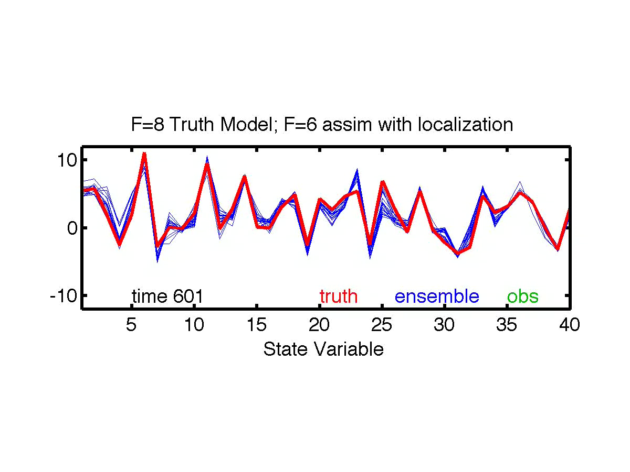
Making it work: Inflation
Assimilating with simulated model error.
dXi / dt = (Xi+1 - Xi-2)Xi-1 - Xi + F.
For truth, use F = 8.
In assimilating model, use F = 6.

Slide 77
Making it work: Inflation
Reduce confidence in prior to deal with model error.
Use inflation.
Simply increase prior ensemble variance for each state variable.
Adaptive algorithms use observations to guide this.

Slide 78
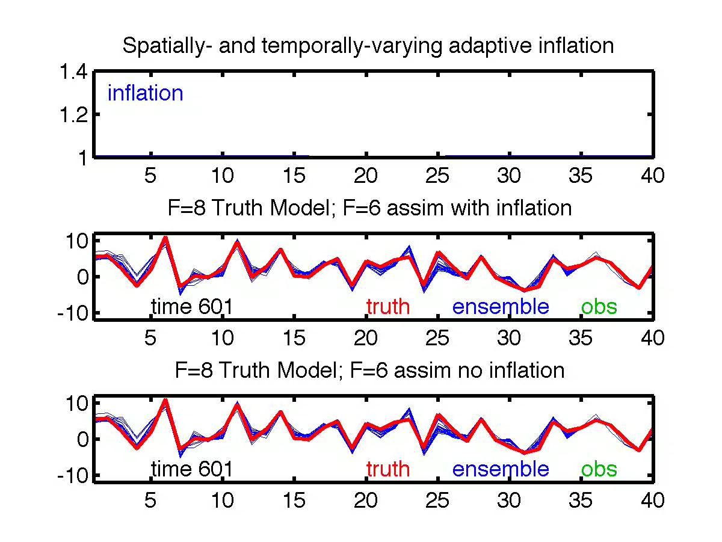
Making it work: Inflation
Inflation is a function of state variable and time.
Automatically selected by adaptive inflation algorithm.

Slide 79
A Fast, Simple, Sequential Ensemble Kalman Filter
A one-dimensional ensemble Kalman filter.
One observed, one unobserved variable.
Ensemble Kalman Filter: A full implementation.
Making it work:
Localization
Inflation
Parameter estimation.
Some sample applications.

Slide 80
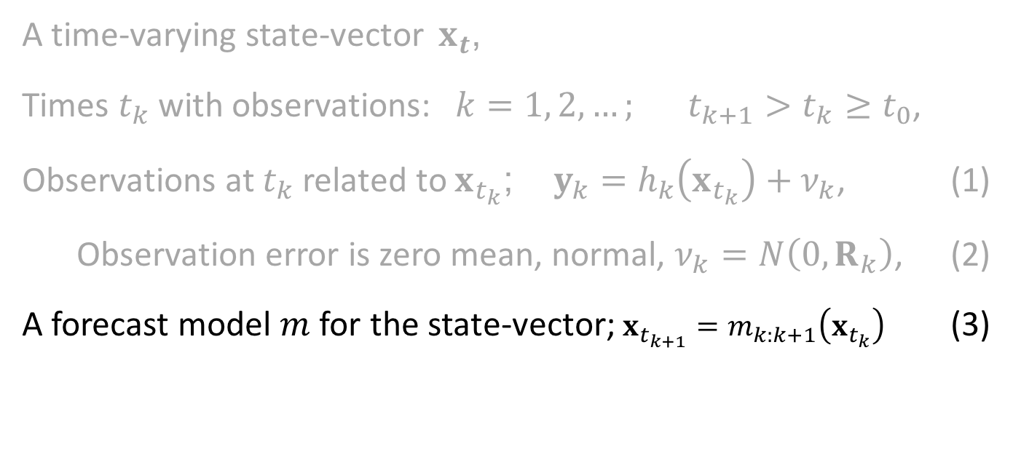
Parameter Estimation
A time-varying state-vector $x_{t}$,
Times $t_{k}$ with observations: $k=1, 2, …; t_{k+1}>t_{k}≥t_{0}$,
Observations at $t_{k}$ related to $x_{t_{k}}$; $y_{k}=h_{k}\left(x_{t_{k}}\right)+ν_{k}$, (1)
Observation error is zero mean, normal, $ν_{k}=N\left(0,R_{k}\right)$, (2)
A forecast model $m$ for the state-vector; $x_{t_{k+1}}=m_{k:k+1}\left(x_{t_{k}}\right)$ (3)
Notes:
s01f01.eps

Slide 81
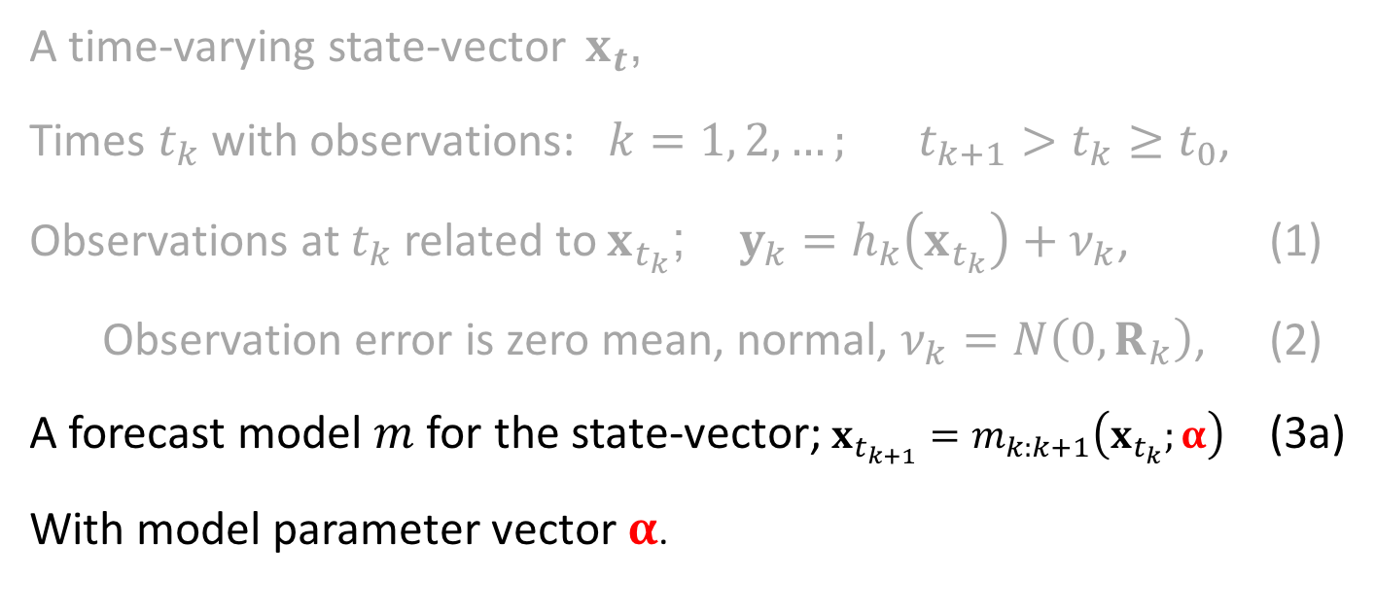
Parameter Estimation
A time-varying state-vector $x_{t}$,
Times $t_{k}$ with observations: $k=1, 2, …; t_{k+1}>t_{k}≥t_{0}$,
Observations at $t_{k}$ related to $x_{t_{k}}$; $y_{k}=h_{k}\left(x_{t_{k}}\right)+ν_{k}$, (1)
Observation error is zero mean, normal, $ν_{k}=N\left(0,R_{k}\right)$, (2)
A forecast model $m$ for the state-vector; $x_{t_{k+1}}=m_{k:k+1}\left(x_{t_{k}};α\right)$ (3a)
With model parameter vector $α$.
Notes:
s01f01.eps

Slide 82
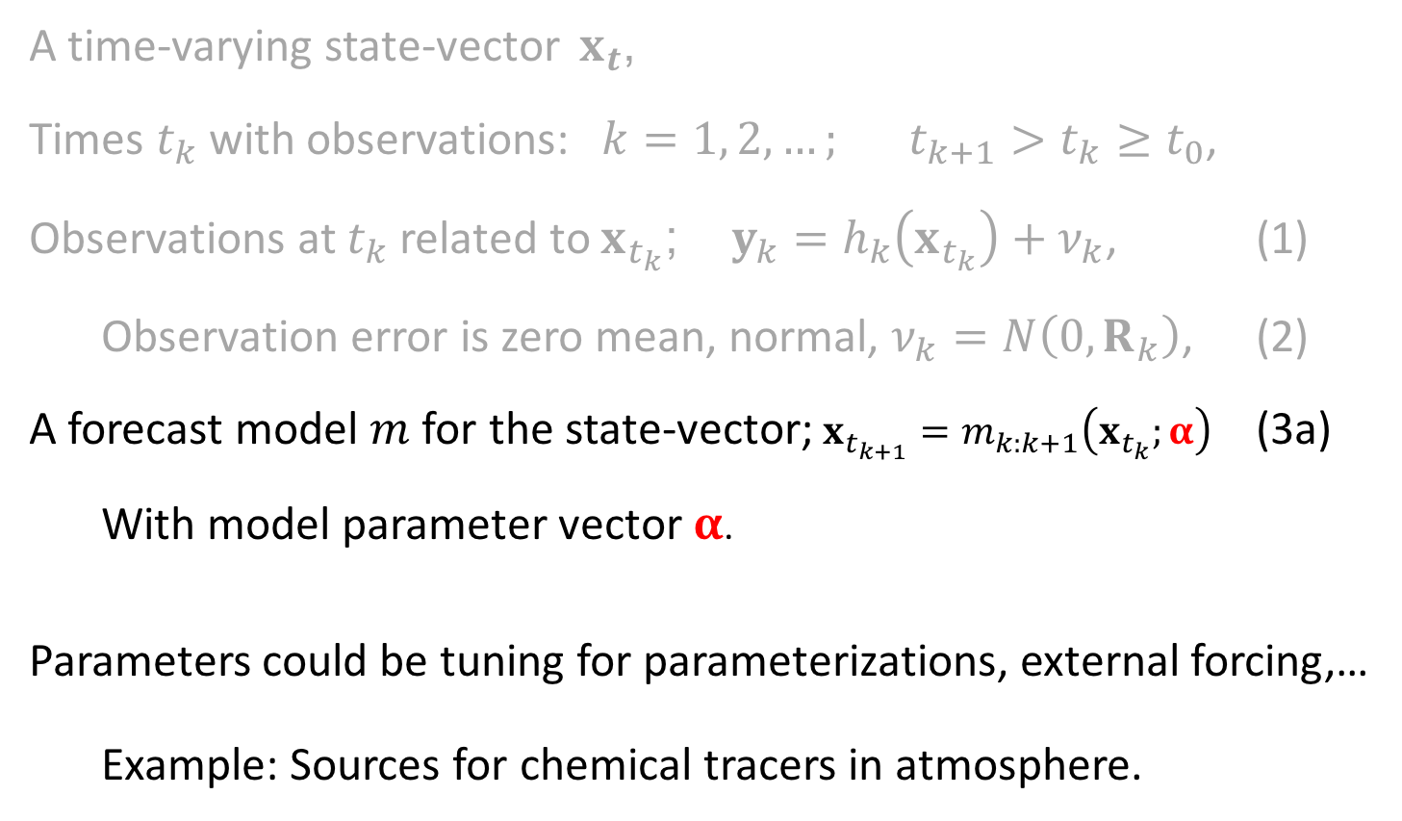
Parameter Estimation
A time-varying state-vector $x_{t}$,
Times $t_{k}$ with observations: $k=1, 2, …; t_{k+1}>t_{k}≥t_{0}$,
Observations at $t_{k}$ related to $x_{t_{k}}$; $y_{k}=h_{k}\left(x_{t_{k}}\right)+ν_{k}$, (1)
Observation error is zero mean, normal, $ν_{k}=N\left(0,R_{k}\right)$, (2)
A forecast model $m$ for the state-vector; $x_{t_{k+1}}=m_{k:k+1}\left(x_{t_{k}};α\right)$ (3a)
With model parameter vector $α$.
Parameters could be tuning for parameterizations, external forcing,…
Example: Sources for chemical tracers in atmosphere.
Notes:
s01f01.eps

Slide 83
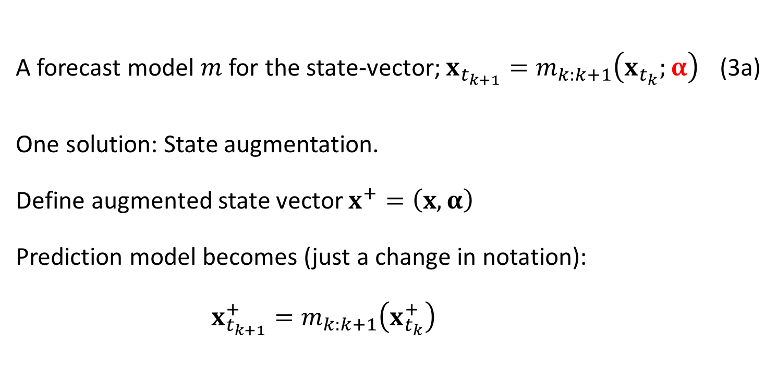
Parameter Estimation
A forecast model $m$ for the state-vector; $x_{t_{k+1}}=m_{k:k+1}\left(x_{t_{k}};α\right)$ (3a)
One solution: State augmentation.
Define augmented state vector $x^{+}=\left(x,α\right)$
Prediction model becomes (just a change in notation):
$x_{t_{k+1}}^{+}=m_{k:k+1}\left(x_{t_{k}}^{+}\right)$
Notes:
s01f01.eps

Slide 84
Parameter Estimation
State augmentation challenges:
In general, no time prediction model for parameters.
If we had a prediction model, they would just have been state.
Kalman filter prior covariance comes from prediction model.
Notes:
s01f01.eps

Slide 85
Parameter Estimation
State augmentation challenges:
In general, no time prediction model for parameters.
If we had a prediction model, they would just have been state.
Kalman filter prior covariance comes from prediction model.
Prior ensembles for parameters must be specified.
Prior sample covariance controls impact of observations on parameters.
If prior covariance is not well-known, estimating parameters can be challenging.
Notes:
s01f01.eps

Slide 86
A Fast, Simple, Sequential Ensemble Kalman Filter
A one-dimensional ensemble Kalman filter.
One observed, one unobserved variable.
Ensemble Kalman Filter: A full implementation.
Making it work:
Localization
Inflation
Parameter estimation.
Some sample applications.

Slide 87
The Data Assimilation Research Testbed (DART)
DART provides data assimilation ‘glue’ to build ensemble forecast systems for the atmosphere, ocean, land, …
Prediction Model
Observing System
DART
Analysis
Diagnostics

Slide 88

Some Research using DART & land models
DART Multiple Component Data Assimilation
Started with CCSM4 20th Century 30-member ensemble for all model components
COUPLER
CAM
Important!
There are multiple instances of each model component.
CLM
POP
Abhishek
Chatterjee now at NASA Goddard.
DART
DART
DART
DART
observations
ROF
CICE
DART assimilates
observations into components separately

Slide 89

Some of the researchers using CLM/DART
Yong-Fei Zhang (UT Austin, now U Washington)
multisensor snow data assimilation
Andy Fox (NEON, now U Arizona)
flux observations/state estimation
Hanna Post (Jülich, now moved on)
assimilation & parameter estimation
Raj Shekhar Singh (UC Berkeley)
groundwater
Long Zhao (UT Austin)
AMSR-E radiances, empirical vegetated surface RTM, soil moisture (SMAP)
Ally Toure (NASA-Goddard USRA)
brightness temperatures
Yonghwan Kwon (UT Austin)
sensitivity of assimilation of brightness temperatures from multiple
radiative transfer models on estimates of snow water equivalent.
Notes:
For the past months, I have been trying to assimilating AMSR-E radiance (Descending orbit, 10.6 GHz, H- and V- polarization) into CLM to estimate global soil mositure (1.25 degree x 0.9 degree). Thanks to your help, up to now, I have already successfully coupled an empricial vegetated-surface radiative transfer model into DART-CLM, prepared all the input datasets, and got the assimilation run effectively (with 20 ensembles for test run). Currently, I am working on some technical problems and testing the system as well. I will keep you updated on the first results together with more details on what I have done within the following weeks.
Wish you all the best,
Sincerely,
Long

Slide 90

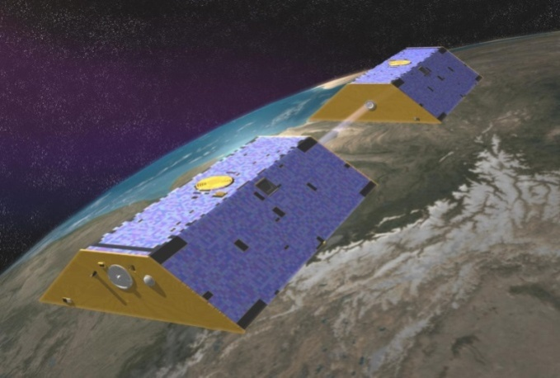
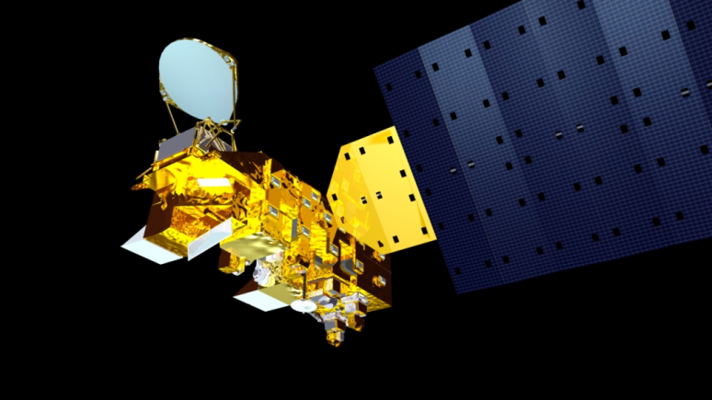




Improving Estimates of Snowpack Water Storage in the Northern Hemisphere Through a Newly Developed Land Data Assimilation System
Yong-Fei Zhang¹, Zong-Liang Yang^{1,2}, Yonghwan Kwon¹, Tim J. Hoar³, Hua Su¹, Jeffrey L. Anderson ³, Ally M. Toure ^{4,5}, and Matthew Rodell ⁵
¹Jackson School of Geosciences, University of Texas at Austin, Austin, TX, United States.
²Key Lab of Regional Climate-Environment for Temperate East Asia (RCE-TEA), Institute of Atmospheric Physics, Chinese Academy of Sciences, Beijing, China.
³The National Center for Atmospheric Research, Boulder, CO, United States.
⁴Universities Space Research Association (USRA), Columbia, MD, United States.
⁵NASA Goddard Space Flight Center, Greenbelt, MD, United States.

Slide 91
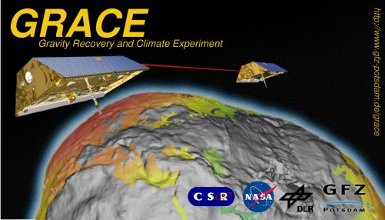
GRACE satellite data
Different from MODIS that measures radiances, GRACE measures the distance between two satellites and retrieves gravitational anomalies. One of the products is a change in monthly total water storage (TWS).

Slide 92
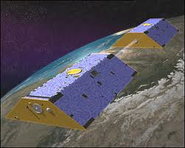
Two passes in GRACE data assimilation
CLM4
CLM4
CLM4
CLM4
CLM4
CLM4
…
Monthly TWS
GRACE ‘Obs’
DART
Analysis
Run CLM for one month to be able to calculate change in monthly total water storage.
Re-run CLM with data assimilation.
Notes:
Grace “observations” … change in total water storage from one month to the next ? Climate Modeler’s Golden Rule refers to “good observations …” … these are highly derived products.
How much information can we tease out of them?

Slide 93
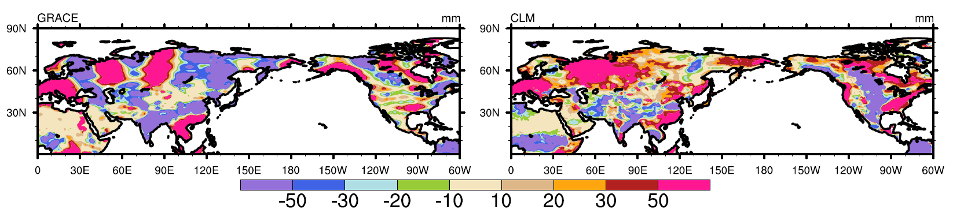
Total Water Storage change Jan 2003
No assimilation.
GRACE
CLM
mm

Slide 94
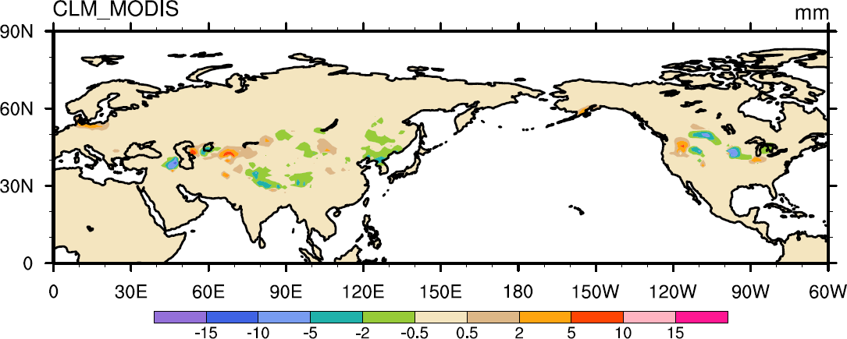
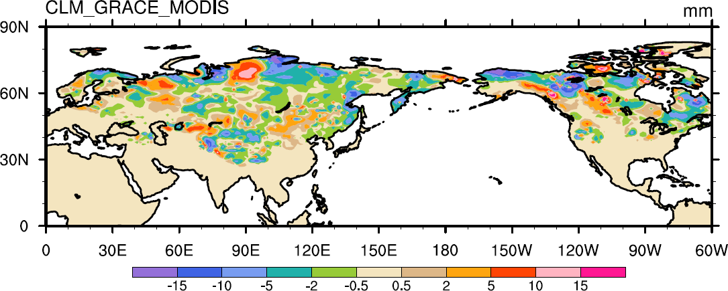
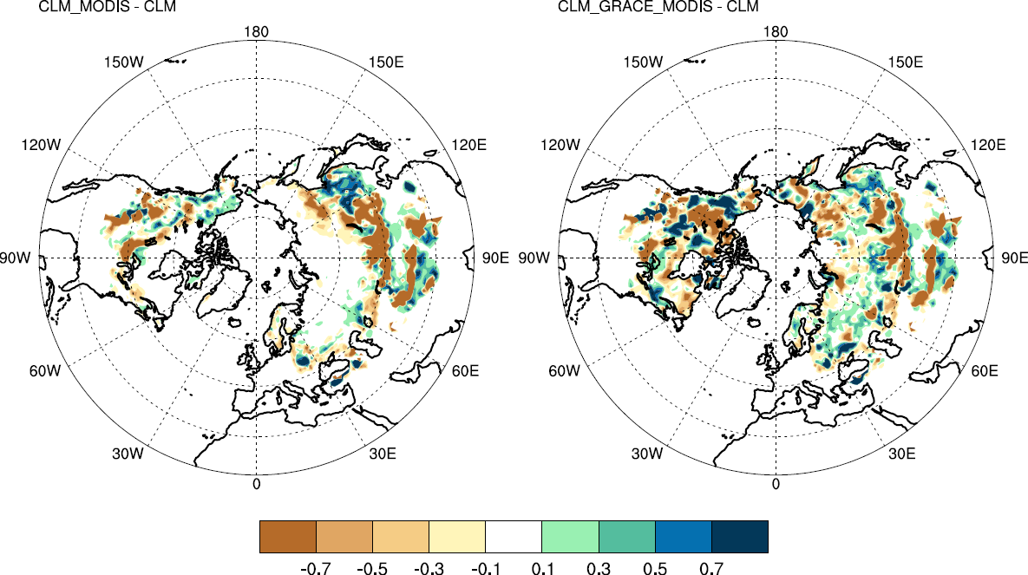
Assimilation Results
Snow Water Storage (Posterior minus Prior)
MODIS assimilation
MODIS and GRACE assimilation

Slide 95
Multi-RTM ensemble approaches in SWE assimilation. Yonghwan Kwon, UT Austin
Develop an advanced radiance assimilation scheme to estimate SWE at continental scale by using multiple snowpack RTMs:
Microwave Emission Model for Layered Snowpacks (MEMLS) and
Dense Media Radiative Transfer – Multi Layers model (DMRT-ML).
CLM4 &
MEMLS
18.7-V
18.7-H
36.5-V
36.5-H
Correlations
between:
CLM4 &
DMRT-ML
MEMLS; Wiesmann and Mätzler, 1999
DMRT-ML; Picard et al., 2013
TJH CESM 2014 pg 95
Notes:
Part of a poster by Liang for the 2013 AGU.
The relationship between SWE assimilation results and AMSR-E TB at continental scale. Please refer to poster H51I-1324 by Kwon et al. (Hydrology session, Friday, Moscone South, Hall A-C) for more information.
Radiance assimilation (RA) has shown promise for improving snow water equivalent (SWE) estimates. For RA, the radiative transfer model (RTM) should be incorporated into a data assimilation system as an observational operator predicting brightness temperature (Tb) and thus the quality of the assimilation results may be strongly affected by the uncertainty of the RTM. As a preliminary study for a successful data assimilation, in this study, we aim to analyze the error characteristics of the coupled land surface-radiative transfer models (LSM/RTMs); for this, we used the Community Land Model version 4 (CLM4) and two snowpack RTMs, Microwave Emission Model for Layered Snowpacks (MEMLS) and the Dense Media Radiative Transfer - Multi Layers model (DMRT-ML). We characterized the errors of the coupled CLM4/DMRT-ML and CLM4/MEMLS by comparing their performance in simulating snowpack states and Tb, and by analyzing the correlations between SWE and Tb errors. SWE simulations by CLM4 show fairly good agreement with the observations for the NASA Cold Land Processes Field Experiment (CLPX) Local Scale Observation Site (LSOS) (point-scale and non-vegetated case); however, mainly due to the lack of precipitation data, SWE is overestimated for the Fraser Meso-cell Study Areas (MSAs) and underestimated for the Rabbit Ears MSA (local-scale and vegetated case). Both the coupled models show comparable performance in predicting Tb at 18.7 and 36.5 GHz vertical (V) and horizontal (H) polarization channels; the performances of CLM4/DMRT-ML and CLM4/MEMLS are slightly better for the Rabbit Ears MSA and Fraser MSA, respectively. Over the LSOS, CLM4/DMRT-ML shows better performance for 18.7-H while CLM/MEMLS shows better performance for 36.5-V. The results in this study show that the correlation between errors of SWE and Tb is not always in the same direction: low correlation for the LSOS, negative correlation for the Fraser MSA, and positive correlation for the Rabbit Ears MSA. Our analyses suggest that the grain radius error is the potential source of correlations between SWE and Tb errors and thus the success of SWE update in RA scheme can be significantly influenced by the grain radius error. Error characteristics of the coupled models at the continental-scale are also analyzed.

Slide 96

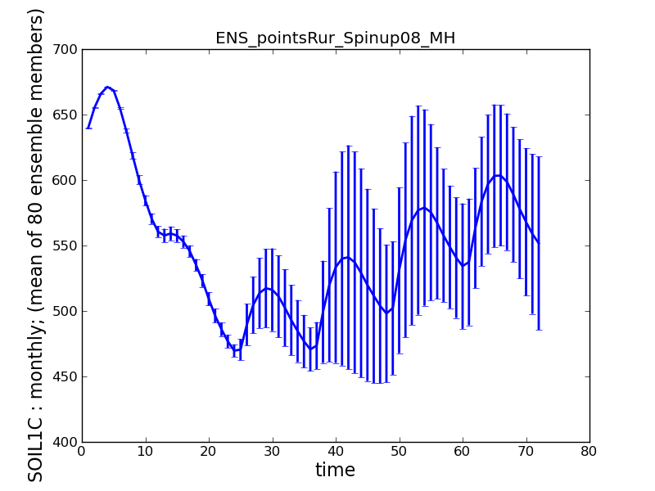
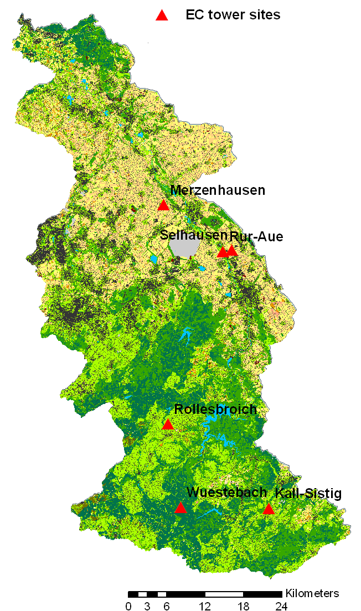
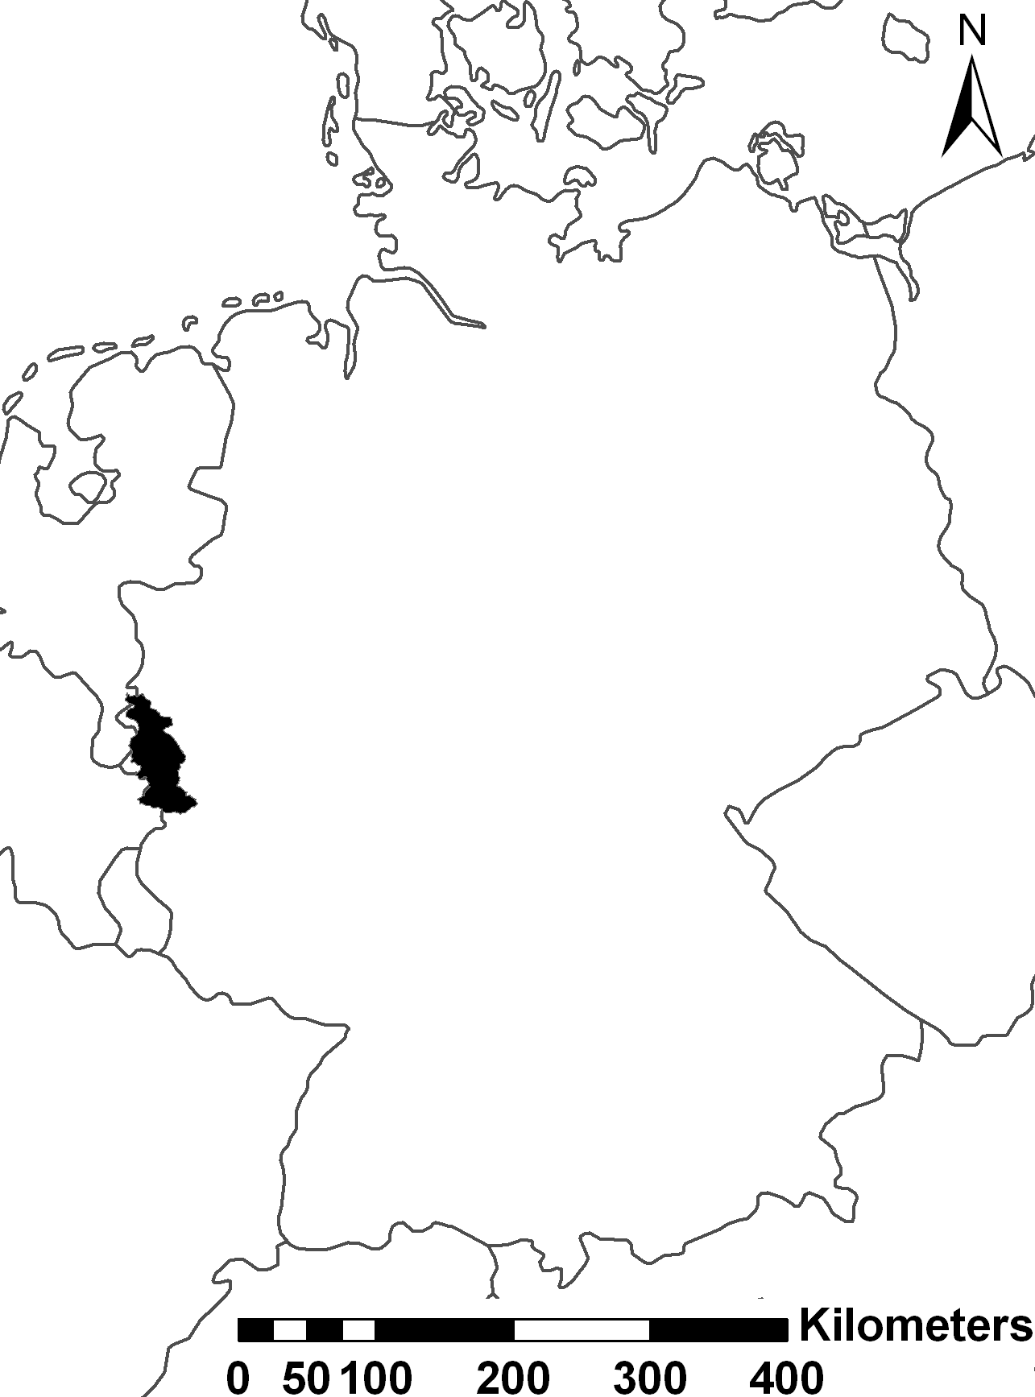
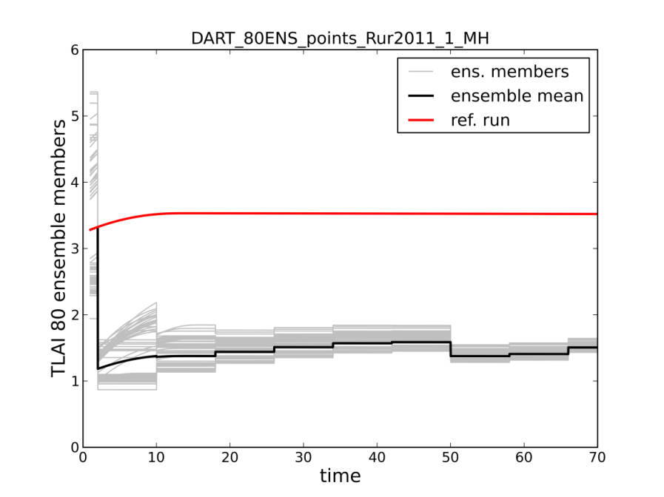

Assimilation of eddy covariance fluxes & MODIS LAI data and CLM upscale NEE from plot to catchment scale
Hanna Post visited NCAR for 3 months in 2015.
Notes:
In Rur-catchment: different eddy covariance (EC) towers on sites of different land use measuring net carbon and energy fluxes
Upper plot: second spinup (6 years) with perturbed climate forcings to generate perturbed initial states
Bottom plot: assimilation of LAI data (Data not plotted here). The reference run is also the ensemble mean but without data assimilation.
Parameters will be estimated with DREAM (and DART)
States will be estimated with DART, but assimilation of EC fluxes to update states is challenging, because EC fluxes are not states → sensitivity / linear correlation of fluxes states that can be updated instead is required.

Slide 97
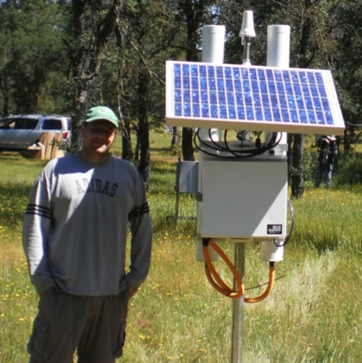
NOAH-DART: Integrated Soil Moisture

Slide 98
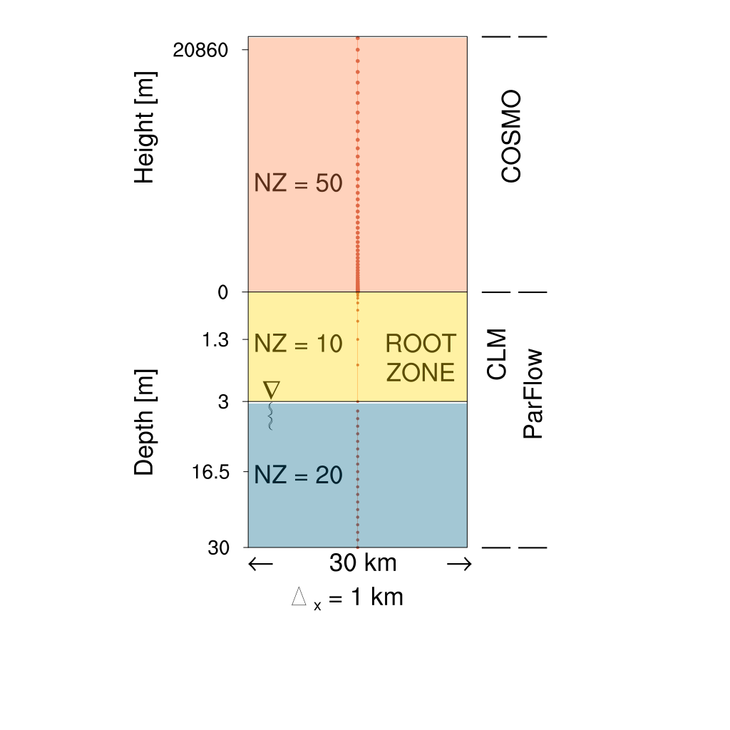
TerrSysMP: COSMO-CLM-ParFlow
Perfect model results
COSMO
CLM
ParFlow
Prabhakar Shrestha
pshreshta@uni-bonn.de
“The terrestrial system modeling platform (TerrSysMP) was developed to simulate the interaction between lateral flow processes in river basins with the lower atmospheric boundary layer.
It features three model components: COSMO, CLM , ParFlow and an external coupler OASIS3 that drives the system. This platform allows explicit modeling of land-atmosphere interactions across scales ranging from meters to kilometers via mosaic and downscaling / upscaling approaches. New parameterizations for root water uptake, additional plant function types, downscaling algorithms, and CO₂ exchange processes have also been implemented into TerrSysMP in collaboration with B and C science clusters, and are currently being tested.”
http://tr32new.uni-koeln.de/index.php/terrysysmp Terrestrial System Modeling Platform (TerrSysMP)
git.meteo.uni-bonn.de provides access to TerrSysMP
Notes:
Prabhakar basically did this on his own …

Slide 99

Recent Papers on Snow DA & DART
Zhao, L., Z. -L. Yang, and T. J. Hoar, 2016
Global soil moisture estimation by assimilating AMSR-E brightness temperatures in a coupled
CLM4-RTM-DART system. Journal of Hydrometeorology, 17, 2431-2454
doi:10.1175/JHM-D-15-0218.1
Kwon, Y., Z. -L. Yang, L. Zhao, T. J. Hoar, A. M. Toure, and M. Rodell, 2016
Estimating snow water storage in North America using CLM4, DART, and snow radiance
data assimilation. Journal of Hydrometeorology, 17, 2853-2874
doi:10.1175/JHM-D-16-0028.1
Kwon, Y., Z. -L. Yang, T. J. Hoar, and A. M. Toure, 2017
Improving the radiance assimilation performance in estimating snow water storage across
snow and land-cover types in North America. Journal of Hydrometeorology, 18, 651-668
doi:10.1175/JHM-D-16-0102.
Notes:
From Kwon, 2016: The background image is a sequence of panels incrementally adding snow water equivalent and snow depth (swe), then
swe + snow grain raidius (sr)
sr + snow temperature (srt)
srt + SOIL water content and temperature (srts)
srts + RTM parameters (srtsp)
The left side is snow depth, the right side is snow cover fraction.
Here, we used DMRT-ML (Picard et al. 2013) to estimate microwave T_{B} from the snowpack. DMRT-ML is a multilayer microwave emission model that calculates the microwave scattering and absorption coefficients of snowpack based on the Dense Media Radiative Transfer (DMRT) theory (Tsang and Kong 2001). We can also use Microwave Emission Model for Layered Snowpacks (MEMLS) (Wiesmann and Mätzler 1999)
All experiments were driven by the 40 randomly chosen ensemble members of the DART/CAM4 reanalysis over North America for December 2002 to February 2003. In the RA cases, AMSR-E T_{B} observations at two frequency channels (i.e., 18.7-V and 36.5-V) were assimilated.

Slide 100
A Fast, Simple, Sequential Ensemble Kalman Filter
A one-dimensional ensemble Kalman filter.
One observed, one unobserved variable.
Ensemble Kalman Filter: A full implementation.
Making it work:
Localization
Inflation
Parameter estimation.
Some sample applications.
Some Additional Applications.

Slide 101
DART Science and Collaborators (1)
Science: A global atmospheric ensemble reanalysis.
Collaborators: Model Developers at NCAR
Assimilation uses 80 members of 2º FV CAM forced by a single ocean (Hadley+ NCEP-OI2) and produces a very competitive reanalysis.
O(1 million) atmospheric obs are assimilated every day.
500 hPa GPH
Feb 17 2003
1998-2010
4x daily
is available.

Slide 102
DART Science and Collaborators (2)
Science: Do new satellite observations of cloud motion improve hurricane forecasts?
Atmospheric motion vectors from CIMMS at University of Wisconsin.
Collaborator: Ting-Chi Wu,
Graduate Student,
University of Miami.

Slide 103
DART Science and Collaborators (2)
Tropical Cyclones and Atmospheric Motion Vectors
Wu et al., 2014, MWR, 142, 49–71.

Slide 104
DART Science and Collaborators (3)
Science: Where should more observations be taken to
improve landfall forecasts?
Ensemble sensitivity analysis for Katrina.
Collaborator: Ryan Torn, University at Albany.

Slide 105

DART Science and Collaborators (3)
Hurricane Katrina Sensitivity Analysis
Contours are ensemble mean 48h forecast of deep-layer mean wind.
Color shows where observations could help.

Slide 106
Identifying Model Systematic Errors
Prediction Model
Observing System
Identify
Systematic
Errors
Data Assimilation
Analysis
Diagnostics

Slide 107
DART Science and Collaborators (4)
Science: Diagnosing and correcting errors in the CAM FV core.
Collaborator: Peter Lauritzen, CGD.

Slide 108

DART Science and Collaborators (4)
Gridpoint noise detected in CAM/DART analysis
CAM FV core - 80 member mean - 00Z 25 September 2006

Slide 109

DART Science and Collaborators (4)
Suspicions turned to the polar filter (DPF)
CAM FV core - 80 member mean - 00Z 25 September 2006

Slide 110

DART Science and Collaborators (4)
Continuous polar filter (alt-pft) eliminated noise.

Slide 111

DART Science and Collaborators (4)
Differences mostly in transition region of default filter.

Slide 112
DART Science and Collaborators (4)
The use of DART diagnosed a problem that had been unrecognized (or at least undocumented).
Could have an important effect on any physics in which meridional mixing is important.
The problem can be seen in ‘free runs’ - it is not a data assimilation artifact.
Without assimilation, can’t get reproducing occurrences to diagnose.

Slide 113
DART Science and Collaborators (5)
Science: Global Ocean data assimilation.
Collaborators: Alicia Karspeck, Steve Yeager, CGD.
Climate change over time scales of 1 to several decades has been identified as very important for mitigation and infrastructure planning.
Need ocean initial conditions for the IPCC decadal prediction program (and maybe a crystal ball, too!).

Slide 114


DART Science and Collaborators (5)
World Ocean Database T, S observation counts.
These counts are for 1998 & 1999 and are representative.
FLOAT_SALINITY 68200
FLOAT_TEMPERATURE 395032
DRIFTER_TEMPERATURE 33963
MOORING_SALINITY 27476
MOORING_TEMPERATURE 623967
BOTTLE_SALINITY 79855
BOTTLE_TEMPERATURE 81488
CTD_SALINITY 328812
CTD_TEMPERATURE 368715
STD_SALINITY 674
STD_TEMPERATURE 677
XCTD_SALINITY 3328
XCTD_TEMPERATURE 5790
MBT_TEMPERATURE 58206
XBT_TEMPERATURE 1093330
APB_TEMPERATURE 580111

Slide 115

Physical Space: 1998/1999 SST Anomaly from HadOI-SST
Coupled Free Run
POP forced by observed atmosphere (hindcast)
48 POP 48 CAM
23 POP 1 DATM

Slide 116
DART Science and Collaborators (6)
Science: Land surface analysis with DART/CLM.
Collaborator: Yongfei Zhang, UT Austin.
Land surface analysis with DART/CLM:
Estimate snow water equivalent with observations
of snow cover fraction from satellites (MODIS).

Slide 117

Assimilation of MODIS snow cover fraction
80 member ensemble for onset of NH winter
Assimilate once per day
Level 3 MODIS product – regridded to a daily 1 degree grid
Observation error variance is 0.1 (for lack of a better value)
Observations can impact state variables within 200km
CLM variable to be updated is the snow water equivalent “H2OSNO”
Standard deviation of the snow cover fraction initial conditions for Oct. 2002

Slide 118



An early result: assimilation of MODIS snowcover fraction on total snow water equivalent in CLM.
Thanks Yongfei!
kg/m2
Prior for Nov 30, 2002
kg/m2
Increments (Prior – Posterior)
The model state is changing in reasonable places, by reasonable amounts. At this point, that’s all we’re looking for.
Focus on the non-zero increments

Slide 119
DART Science and Collaborators (7)
Science: Regional Atmospheric Chemistry.
Collaborator: Arthur Mizzi, NCAR/ACD.

Slide 120
WRF/Chem Chemical Weather Forecast System
WRF-Chem – Weather Research and Forecasting Model (WRF) with online chemistry.
Meteorological Observations – NOAA PREPBUFR conventional observations.
Chemistry Observations – MOPITT CO retrieval profiles (also IASI CO retrievals – results not shown).

Slide 121
WRF/Chem Chemical Weather Forecast System
WRF/Chem-DART cycling with conventional meteorological observations and MOPITT CO V5 retrieval profiles.
Continuous six-hr cycling (00Z, 06Z, 12Z, and 18Z).
CONUS grid with 101x41x34 grid points and 100 km resolution.
20-member ensemble.
June 1 - 30, 2008 (112 cycles) study period.
Full state variable/obs interaction.
Initial and lateral chemical boundary conditions from MOZART-4 simulation.
Emissions: Biogenic – MEGAN, Anthropogenic – global inventories, and Fire – Fire Inventory from NCAR (FINN).

Slide 122
WRF/Chem Chemical Weather Forecast System
Two experiments:
Exp 1: PREPBUFR conventional obs (CNTL DA).
Exp 2: MOPITT CO retrieval profiles and PREPBUFR conventional obs (CHEM DA).

Slide 123
WRF/Chem Chemical Weather Forecast System

Slide 124
DART Science and Collaborators (8)
Science: Global Atmospheric Chemistry.
Collaborators: Jerome Barre,
Benjamin Gaubert, NCAR/ACD.
Uses global CAM/Chem model, 1 degree.
Have full meteorological assimilation capability already.

Slide 125

CAM/Chem Chemical DA System
MOPITT CO:
On TERRA satellite
tropospheric profiles
Global coverage in 4 days
Multispectral retrievals
high sensitivity on surface land/day
IASI CO:
On MetOpA satellite
tropospheric profiles
Global coverage in 1 day
Only thermal infrared
Sensitivity on upper PBL &
mid troposphere
Notes:
Now we want to evaluate the chemical data assimailtion system.
As CO observation we have used MOPITT CO on terra that retrive a troposphere profile
It covers the globe in 4 days
On the other hand we have also assimilated iasi CO, on metopa
Iasi has a larger swath and covers the globe in 1 day
This is not a multispectral instrument then it has less sensitivity in the lowermost troposphere over land

Slide 126




CAM/Chem Chemical DA System
Control run: Met Only assimilated
MOPITT run: Met + MOPITT assimilated
IASI run: Met + IASI assimilated
Combined run: Met + MOP+ IASI assimilated
Notes:
So we perform 4 experiments
A control run with only meteorology assimilated
A mopitt run where we add mopitt assimialtion
A iasi run where we add iasi assimialtion
And also a combined run
CO assimilation globally increases CO. the effect of mopitt Is lower than the effect of iasi and that could easily be explained by the denser data coverage of iasi.
When the two instruments are asimialted, the combined run look very similar to the iasi run.

Slide 127



Learn more about DART at:
www.image.ucar.edu/DAReS/DART
dart@ucar.edu
Anderson, J., Hoar, T., Raeder, K., Liu, H., Collins, N., Torn, R., Arellano, A., 2009: The Data Assimilation Research Testbed: A community facility.
BAMS, 90, 1283—1296, doi: 10.1175/2009BAMS2618.1

